Slide 1
Order Summary

Slide 2
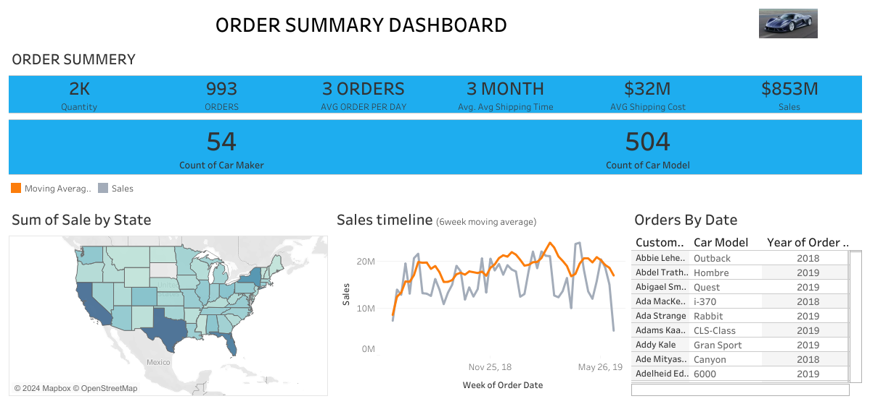

Slide 3
Sales Summary

Slide 4
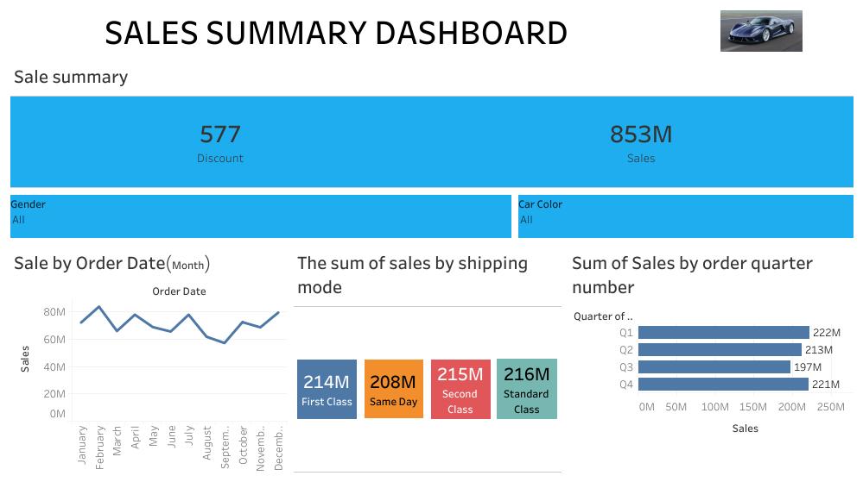

Slide 5
CUSTOMER FEEDBACK DASBOARD

Slide 6
